Slide 1

JAWAHARLAL NEHRU TECHNOLOGICAL UNIVERSITY ANANTAPUR,(ANANTHAPURAM)
SCHOOL OF MANAGEMENT STUDIES
A COMPARATIVE STUDY ON CRYPTOCURRENCY AND BANKING TRANSACTION
AT
ICICI BANK ANANTAPUR
Submitted By: Under The Guidance Of :
R.NIKHILESWAR Dr.B.C.Lakshmannna
200A1E0308 BL, MBA, PhD,

Slide 2
INTRODUCTION
Banks are controlled and supervised by government, but Cryptocurrency are decentralized and not backed by any government. Sometimes Bank faces single point of failure and cryptocurrency don’t face any single point of failure.
The majority of cryptocurrencies are built on a peer-to-peer settlement system and are completely operational 24/7 including holidays and weekends. The prices are cheaper compared with banks, and there is no need for the intermediary.

Slide 3
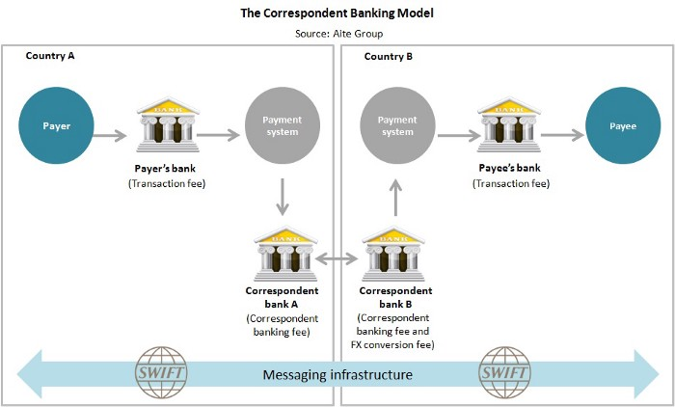

Slide 4
MEANING AND DEFINITION
Banking is one of the most sensitive and vulnerable areas of the financial sector to cyber threats. Several banks throughout the world have reported major cyber threats in recent years, including direct attacks on centralized systems that resulted in billions of dollars in losses.
Cryptocurrency is a digital payment system that doesn't rely on banks to verify transactions. It’s a peer-to-peer system that can enable anyone anywhere to send and receive payments. Instead of being physical money carried around and exchanged in the real world, cryptocurrency payments exist purely as digital entries to an online database describing specific transactions. When you transfer cryptocurrency funds, the transactions are recorded in a public ledger.

Slide 5
BANKING TRANSACTION
Banks profit handsomely from facilitating payments, so they have no motivation to reduce rates. Payments revenues from cross-border transactions, such as payments and letters of credit, totaled $224 billion in 2019.
Example: If a person works in USA and wish to send a portion of pay check to their family in India, person may have to pay a $25 wire transfer fee plus additional fees of up to 7%. Person’s bank takes a share, as does the receiving bank, and person pay exchange rate fees.

Slide 6
CRYPTOCURRENCY TRANSACTION
Cryptocurrency are flawless design which provides peer to peer and transparent transaction options, after enjoying the taste of flawless design none of the person will choose the normal bank transaction over cryptocurrency transaction .
In decentralized currency, the central party is superseded by an internal protocol framework governing the system functioning and allowing the system members to verify transactions on their own.
Digital currencies are digital representations of value, issued by private developers and denominated in their own unit of account.

Slide 7
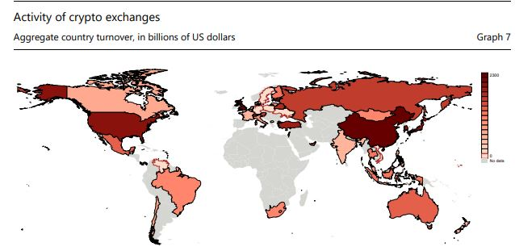

Slide 8
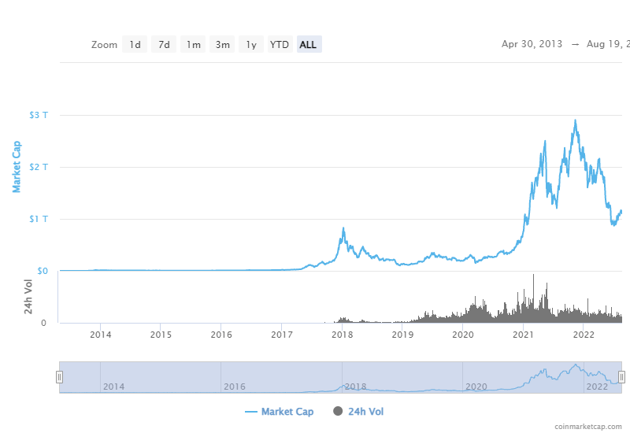

Slide 9
DECENTRALIZED VS CENTRALIZED TRANSACTIONS
Banking is one of the most sensitive and vulnerable areas of the financial sector to cyber threats.
Several banks throughout the world have reported major cyber threats in recent years, including direct attacks on centralized systems that resulted in billions of dollars in losses, because of the vast amounts of money held in its databases.
As a response, governments have issued tough directives, and huge institutions have begun to investigate ways to use advanced decentralized asset solutions like as blockchain. The main advantage of cryptocurrency transaction is that it runs and operate without a single point of failure.
The majority of cryptocurrencies are built on a peer-to-peer settlement system and are completely operational 24/7 including holidays and weekends.
The prices are cheaper compared with banks, and there is no need for the intermediary, and there is service available and operational 24/7, and the supply is fixed, cryptography better matches with ideological goals.

Slide 10
INDUSTRY PROFILE
Banks play a key role in the entire financial system by mobilizing deposits from households spread across the nation and making these funds available for investment, either by lending or buying securities. Today the banking industry has become an integral part of any nation’s economic progress and is critical for the financial wellbeing of individuals, businesses, nations, and the entire globe.
The global cryptocurrency market size was valued at $1.49 billion in 2020, and is projected to reach $4.94 billion by 2030, growing at a CAGR of 12.8% from 2021 to 2030. Transparency or distributed ledger technology and growth in venture capital investments are the key factors driving the growth of the market.

Slide 11
ICICI BANK COMPANY PROFILE
Type : Public
Industry : Banking, Financial services
Founded : 5 January 1994; 26 years ago
Area served : Worldwide
Key people : Girish Chandra Chaturvedi (Chairman), Sandeep Bakhshi (MD & CEO)
Revenue : Rs. 91,246.94 crore
Operating Income : Rs. 20,711 crore
Net income : Rs. 6,709 crore
Total assets : Rs. 1,007,068 crore
Turnover : Rs. 86,374 crore
No.of employees : 84,922 (2019).
Website : www.icicibank.com

Slide 12
NEED OF THE STUDY
This Study helps one to understand how cryptocurrency works and benefits of having a decentralized system of monetary management.

Slide 13
SCOPE OF THE STUDY
This Study is helpful to know the Advantages and Drawbacks of Cryptocurrency Transaction and Banking Transaction. The Study is limited to Anantapur and covers only last 10 years i.e., (2010-2011) to (2020-2021).

Slide 14
OBJECTIVES OF THE STUDY
To Study the awareness and perception level of cryptocurrency among people in ICICI Bank.
To Identify the various factors which impacts on investors decision making of cryptocurrency and banking transaction at ICICI Bank.
To Calculate the willingness of people to choose Cryptocurrency as an investment tool at ICICI Bank.

Slide 15
HYPOTHESIS TESTING
H0 :
There is no Significant Difference between Banking Transaction and Cryptocurrency Transaction.
HA :
There is a Significant Difference between Banking Transaction and Cryptocurrency Transaction.

Slide 16
RESEARCH METHODOLOGY
Primary Data:
Primary data is collected through well Structured Questionnaire.
Sampling Method : Snowball Sampling Method.
The sample size is 108
Secondary Data :
The data was collected through E-journals , Research Articles ,
Reports, Magazines, Broachers, Websites.
https://coinmarketcap.com
Notes:
CONFIDENCE LEVEL = 95%
MARGIN OF ERROR = 5%
POPULATION PORTION = 10%
POPULATION SIZE = UNKNOWN

Slide 17
LIMITATIONS OF THE STUDY
This study is limited to 10 years comparison of cryptocurrency and traditional currency in ICICI Anantapur only.
Price volatility in Cryptocurrencies and Banking Transaction

Slide 18
TOOLS AND TECHNIQUES
Tools :
Charts
Forms
Techniques:
Correlation
Software:
MS Excel

Slide 19
DATA ANALYSIS
AND
INTERPRETATION

Slide 20
DATA ANALYSIS
The data analysis includes the processing of all the data collected through survey in form questionnaire, to convert it some usable form, so that required information can be extracted and conclusion can be drawn from that information.
The data collected through primary data sources (questionnaire survey method) were tabulated and calculated in percentage form. Analysis were done on the basis of tabulated data. The further analysis of data was done either through bar graph (2D diagram) or Pie Chart and interpretations were carried out on the basis of those graphs.

Slide 21
Gender of the Respondents
SL.NO | RESPONSE | NO OF RESPONDANTS | PERCENTAGE
1 | Male | 73 | 68.86
2 | Female | 31 | 29.24
3 | Prefer not to Say | 2 | 1.8
4 | Total | 106 | 100
Among all the respondents 73 are male, 31 are female and 2 respondents are not in favor of disclosing their gender.

Slide 22
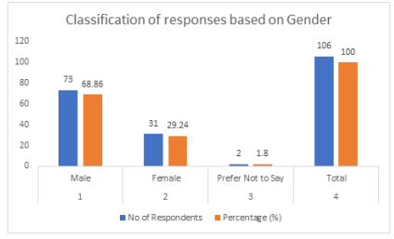
INTERPRETATION
From the above table and graph, it can be observed that, among all the respondents
68.9% are male
29.24% are female
1.8% fall into category who are not willing to disclose their gender.

Slide 23
AGE CATEGORY
SL.NO | RESPONSE | NO OF RESPONDANTS | PERCENTAGE
1 | 20-30 Years | 14 | 13.2
2 | 30-40 Years | 61 | 57.54
3 | 40-50 Years | 28 | 26.21
4 | Above 50 Years | 3 | 2.83
5 | Total | 106 | 100
Among all respondents, 14 belong to the age category of 20-30 years, 61 belong to the 30-40 years age category, 28 belong to the 40-50 years of age category and only 3 belong to the above 50 years.

Slide 24
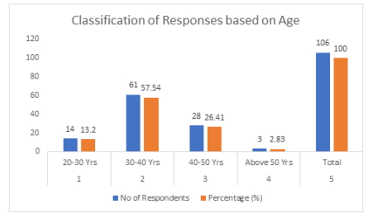
INTERPRETATION
From the above Table and Graph, it can be observed that among all respondents
13.2 % belongs to 20-30 years of age group
57.54% in 30- 40 years
26.41% in 40-50 years
2.83% fall in above 50 years of age.

Slide 25
EDUCATIONAL QUALIFICATION
Among all the respondents, only 1 respondent has Senior Secondary as Educational Qualification, 25 respondents have Bachelor Degree and 78 respondents have Master Degree as their Educational Qualification.

Slide 26
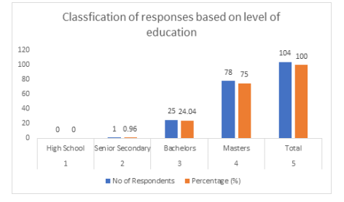
INTERPRETATION
From the above table and Graph, it can be observed that among all respondents
0% belongs to High School,
0.96% belongs to Senior Secondary
24.04% belong to Bachelor degree
75% belong to Master degree.

Slide 27
OCCUPATION
Among all respondents, 3 are Business persons, 92 respondents are employed in various sectors, 4 are students and 7 are unemployed.

Slide 28
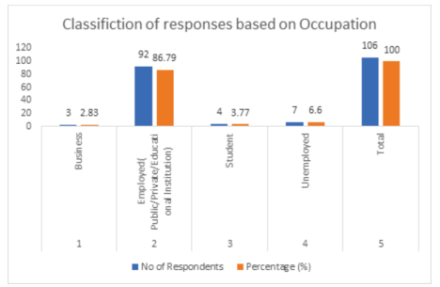
INTERPRETATION
From the above Table and Graph, it is observed that among all respondents
86.79% are employed (public/private/educational institution),
6.6% are unemployed
3.77% are students and 2.83% are business persons.

Slide 29
ANNUAL INCOME
Among all respondents, 17 earn in-between 1-5 lakhs of annual income, 21 respondents earn in-between 5-10 lakhs and 62 respondents earn more than 10 Lakhs

Slide 30
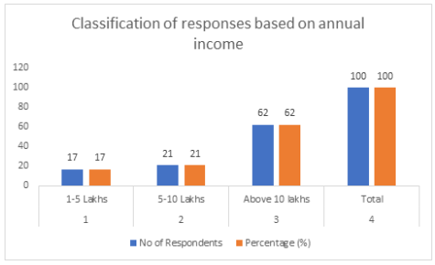
INTERPRETATION
From the above Table and graph, it can be observed that among all respondents
62% earn above 10 lakhs
21% fall under 5-10 lakhs
17% are in between 1-5 lakhs

Slide 31
FAVOURITATE INVESTMENT TOOL
SL.NO | RESPONSE | NO. OF RESPONDANTS | PERCENTAGE(%)
1 | Mutual funds | 56 | 52.83
2 | Equity | 18 | 16.98
3 | Cryptocurrency | 1 | 0.94
4 | Real estate/ Gold | 31 | 29.24
5 | Total | 106 | 100
Among all the respondents, 56 respondents favored the Mutual Funds as their favorite investment tool. 18 respondents favored Equity, 31 favored Real Estate/Gold as their investment tool and only one responded in favor of Cryptocurrency.

Slide 32
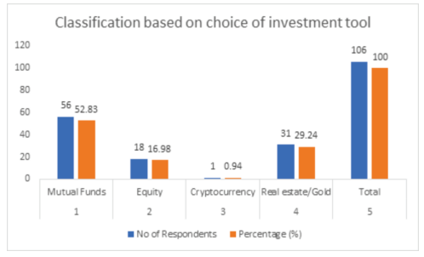
INTERPRETATION
From the above Table and Graph, it can be observed that
52.83% respondents have responded for Mutual Funds
29.24% as Real Estate/ Gold
16.98% as Equity
0.94% have chosen cryptocurrency as their preferred investment tool.

Slide 33
AWARENESS OF CRYPTOCURRENCY.
The maximum number of respondents, i.e. 74 are aware about cryptocurrency, 23 respondents are not aware at all and 9 are not sure about it.

Slide 34
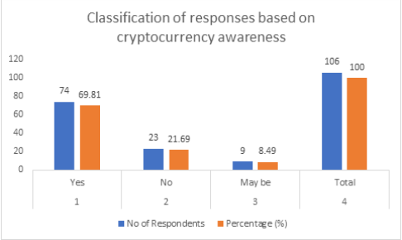
INTERPRETATION
From the above Table and Graph, it is observed that
69.81% respondents are aware of Cryptocurrency
21.69% do not know about it
8.49% are not sure about Cryptocurrency.

Slide 35
KNOWLEDGE OF CRYPTOCURRENCY
Among all the respondents, 31 respondents know the basic framework of Cryptocurrency, 8 respondents have detailed knowledge about cryptocurrency and 52 respondents have only some idea about cryptocurrency.

Slide 36
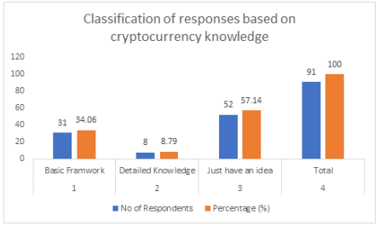
INTERPRETATION
From the above Table and Graph, it is observed that
57.14% respondents have an idea about Cryptocurrency,
34.06% respondents know about its basic framework
8.79% are well knowledgeable in Cryptocurrency.

Slide 37
PREFERENCE TO CHOOSE CRYPTOCURRENCY
Among all the respondents, 35 respondents prefer to see cryptocurrency as Currency form and 57 respondents prefer it to be like Investment tool.

Slide 38
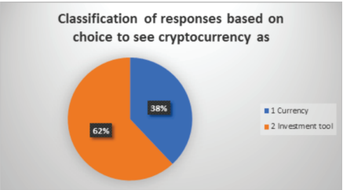
INTERPRETATION
From the above Table and Chart, it is observed that
38.04% of respondents want to see Cryptocurrency as Currency
Rest 61.95% are in favor of Investment tool.

Slide 39
WHETHER TO INVEST IN CRYPTOCURRENCY OR NOT.
Among all the respondents, 20 respondents have shown their interest to invest in Cryptocurrency, 51 respondents are not in favor of investing in Cryptocurrency and 35 respondents are not sure about investing in Cryptocurrency.

Slide 40
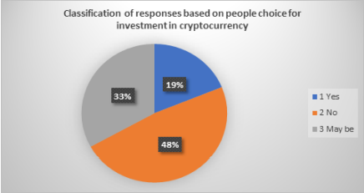
INTERPRETATION
From the above Table and Pie chart, it can be observed that 18.87% respondents are agree to invest in Cryptocurrency
48.11% respondents are not in favour of investment in Cryptocurrency
33.02% are not sure about it.

Slide 41
INVESTMENT % IN CRYPTOCURRENCY
Among all the respondents, 41 are ready to invest less than 5% of their annual income, 13 respondents are interested in investing 5-10% of their annual income and only 4 respondents have shown interest to invest more than 10% of their annual income.

Slide 42
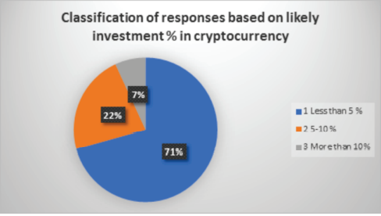
INTERPRETATION
From the above Table and Chart, it is observed that
38.68% would like to invest in Cryptocurrency but less than 5% of their total annual income
22.41% would like to invest in the range of 5-10% of their annual income
6.91% respondents would like to invest more than 10% of their annual income.

Slide 43
RETURN ON INVESTMENT IN CRYPTOCURRENCY
Very less number of respondents have invested in Cryptocurrency. So number of responses are very less. So among all the responses, 19 respondents have got less than 5% of return on investment in Cryptocurrency. 3 respondents have got in between 5-10% of return on investment in cryptocurrency and 5 respondents have got more than 10% of return on investment in Cryptocurrency.

Slide 44
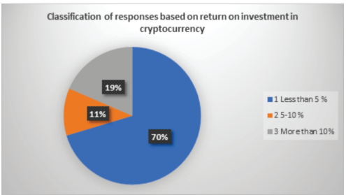
INTERPRETATION
From the above Table and Chart, it is observed that
70.37% respondents got less than 5% of return on investment in cryptocurrency
11.11% got in between the range of 5-10% of return
18.52% got more than 10% of return on investment in Cryptocurrency.

Slide 45
INDIFFERENCE TOWARDS CRYPTOCURRENCY.
Among all the respondents, 12 respondents have sought the reason as legal issues attached with cryptocurrency as their indifference towards cryptocurrency, 42 respondents have shown that they do not have confidence in cryptocurrency, 6 respondents sought the reason as security issues related with cryptocurrency as their indifference towards it and 15 respondents have given the high volatile nature of cryptocurrency as their indifference towards cryptocurrency.

Slide 46
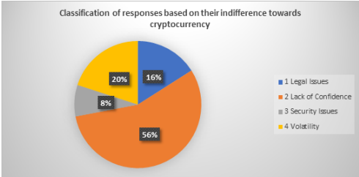
INTERPRETATION
From the above Table and Chart, it is observed that
16% respondents have shown their disinterest towards Cryptocurrency due to legal issues
56% have shown their lack of confidence in Cryptocurrency,
8% see security reasons as their lack of interest towards cryptocurrency
20% sought the reason of disinterest as volatile nature of Cryptocurrency

Slide 47
VIEW ON REGULATION OF CRYPTOCURRENCY
Among all the respondents, 23 respondents are strongly disagreeing for regulation of cryptocurrency, 11 respondents are disagreeing with its regulation, 29 respondents are in neutral position, 18 respondents are in agreement with the regulation of cryptocurrency and 25 respondents are strongly agreeing with the regulation of cryptocurrency.

Slide 48
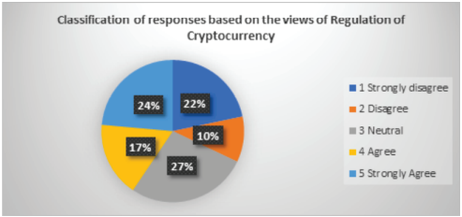
INTERPRETATION
From the above Table and chart, it is observed that, the Government of India and other Regulatory Authorities of India should regularize it or not, so for this
21.70% have shown their strong disagreement
10.38% have shown disagreement
27.36% are in no opinion category
16.98% are in agreement and
23.58% are in strong agreement.

Slide 49
CURRENT REGULATORY AND INFRASTRUCTURAL SUPPORT FOR CRYPTOCURRENCY IN THE COUNTRY.
Among all the respondents, 3 think that we have all the regulatory and infrastructural support, 68 respondents are in view that we do not have regulatory and infrastructural support and 23 are not sure about it.

Slide 50
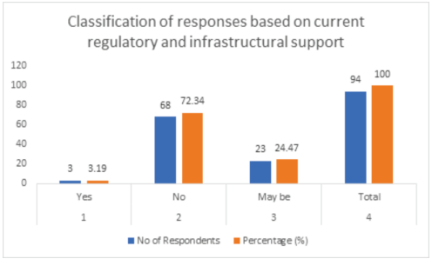
INTERPRETATION
From the above Table and Graph, it is observed that
72.34% respondents have accepted that we do not have all the regulatory and infrastructural support,
24.47% are not sure about it
3.19% are in agreement that we have all kinds of support to regulate it.

Slide 51

CORRELATION
The correlation coefficient describes how one variable moves in relation to another. A positive correlation indicates that the two move in the same direction, with a +1.0 correlation when they move in tandem. A negative correlation coefficient tells you that they instead move in opposite directions. A correlation of zero suggests no correlation at all.

Slide 52
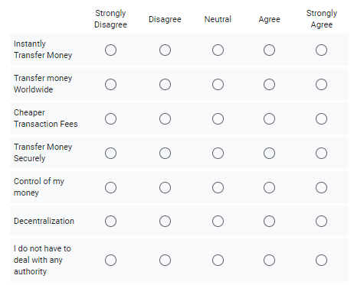
Strongly Disagree = - 2
Disagree = -1
Neutral = 0
Agree = +1
Strongly Agree = +2

Slide 53
Co-Relation B/W Both Transactions
 | Banking Transaction | Crypocurrency Transaction
Instantly Transfer Money | 56 | 18
Transfer money Worldwide | 98 | 50
Cheaper Transaction fees | 78 | 30
Transfer money Securely | 85 | 28
Control of money | 60 | 77
Decentralization | 32 | 70
I do not have to deal with any authority | 40 | 80

Slide 54
INTERPRETATION
From the above Analysis , to compare the difference between Banking Transaction and Cryptocurrency transaction using the correlation technique, they are not closely related and the corelation value is “ -0.53” As a result, Alternate Hypothesis is accepted, Indicating Significant Difference Between Banking Transaction and Cryptocurrency Transaction.

Slide 55
FINDINGS
Majority of the respondents are Male at ICICI Bank.
Most of the respondents fall in the age category of 30-40 years at ICICI Bank.
Majority of the respondents are having Master degree as their highest level of education at ICICI Bank.
Around 75% of the respondents are aware about the Cryptocurrency at ICICI Bank.
Majority of the respondents feel that Cryptocurrency should be regularized as Investment tool at ICICI Bank.
Half of the respondents are not in agreement to invest in Cryptocurrency and rest 35% are not sure about it. Only 15% are ready to invest in cryptocurrency at ICICI Bank.

Slide 56
Among the respondents, those who have already invested in Cryptocurrency, majority have got around 5% of return followed by more than 10% of return on investment in Cryptocurrency at ICICI Bank.
Those respondents who have not shown interest in Cryptocurrency have sought the reason as 'Lack of Confidence in Cryptocurrency' followed by volatility and legal issues at ICICI Bank.
Almost half of the respondents are in view that Government of India should regularize the use of Cryptocurrency at ICICI Bank.
Majority of the respondents have opinion that we do not have infrastructural and regulatory support required for Cryptocurrency adoption at ICICI Bank.

Slide 57
SUGGESTION
As cryptocurrency is a part of decentralized system and it is available across the globe, so it is aptly required to regulate its use to stabilize its demand, as it is very volatile in nature. Its regulation is also important to mitigate its use by illicit users.
As Cryptocurrency inherently imbibe the most innovative technologies of the world currently, so imposing complete ban on it, will be a loss to the millennial generation to learn and experience such innovative product. Therefore, its regulation is justifiable.
As this study was conducted on a very small scale, so the data collected and their findings might be differed from actual perception of people. Therefore, it is advisable and recommendable to conduct a study on large scale to have extensive idea about people's perception.

Slide 58
CONCLUSION
From the above findings, it can be concluded that people in general are aware of the Cryptocurrency and they would like to see it as part of their investment portfolio as it provides good return. But they are not willing to invest in Cryptocurrency due to lack of regulation from Government and regulatory authorities. If Government of India and its regulatory authorities will come forward to regulate its use and transaction in financial market, it can play a major role in entire investment portfolio.
As it is well known that Cryptocurrency is the product of all new age innovative technologies, and many countries of the world have already regulated its use in day to day business and many countries are coming forward to regulate its transaction in financial market. So, Indian Government and its regulatory authority should come forward and take steps to regulate the transactions of Cryptocurrency as investment option.

Slide 59
THANK YOU

